Slide 1

Yerin Kang
Phishing Site
Notes:
Hi, this is Yerin Kang from grade 10 and I am going to present about phishing site today.

Slide 2
TABLE OF CONTENTS /// PHISHING SITE
01.
02.
03.
04.
Introduction
Phishing Site Simulation
What is phishing? Why is it serious problem?
Test phishing site I made with audience
Principle
Protection
How are phishing sites work?
How can I protect myself from phishing sites?
Notes:
This is a table of contents for the presentation.
Before I tell you what is phishing, I have two questions to you. First, have you ever heard about phishing sites? Yes or No? Second, have you ever heard or experienced that someone’s (or your) account is logged in on the strange place? If you say YES, it might be related to phishing sites.

Slide 3

01. INTRODUCTION///WHAT IS PHISHING?
What is phishing?
“Phishing is a method of trying to gather personal information using deceptive e-mails and websites.”
Notes:
First, what is phishing? “Phishing is a method of trying to gather personal information using deceptive e-mails and websites.”

Slide 4
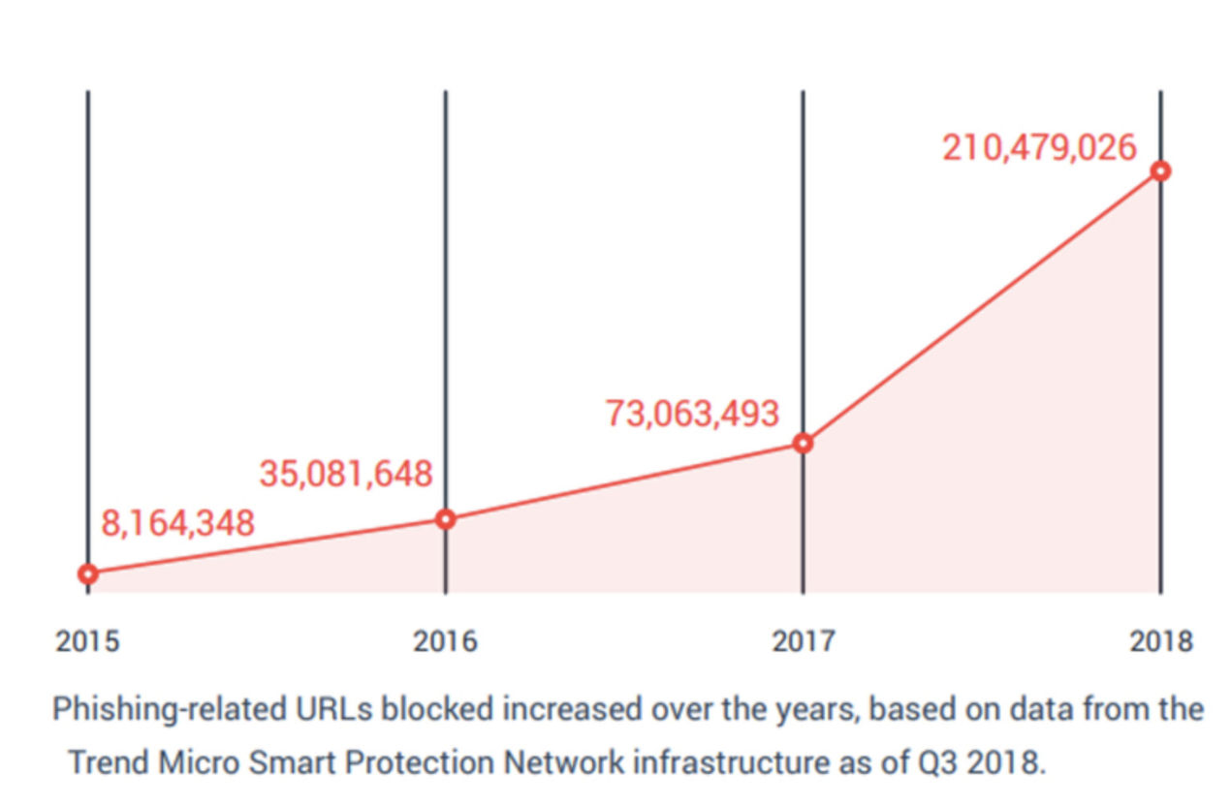
01. INTRODUCTION /// WHY IS IT SERIOUS PROBLEM?
Notes:
As you see on the graph, according to Trend Micro Smart Protection Network infrastructure, phishing-related URLs blocked rapidly increased over the years.

Slide 5
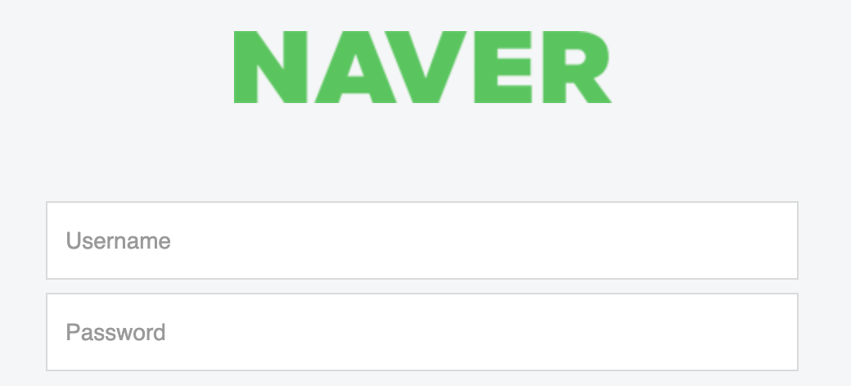
02 PHISHING SITE SIMULATION /// CREATE AN ACCOUNT
ex. coding.yerinkang@naver.com
ex. Coding12345678!
*Do not write your REAL NAVER account ID & PW.
Notes:
Grab a scrap paper or open Note app on your mac. Now, we are going to create virtual NAVER account. This is just example I made. Do not write your real NAVER account ID & PW.

Slide 6
02 PHISHING SITE SIMULATION /// ASSUMPTION
Assumption 01
Assumption 02
Your account is made on NAVER.
01
02
But, you did NOT do any activities on this account for 365 days.
Assumption 03
Start Simulation
You receive KakaoTalk message about deactivation of your account from NAVER.
03
04
Now, read the message carefully and try to solve the deactivation.
NOTE: When you try it, if you keep staying on login page, please say “PROBLEM” on the chat.
Notes:
Now, we are going to make some assumption before starting simulation. Assumption 1, Your account is made on NAVER. Assumption 2, but, you did NOT do any activities on this account for 365 days. Assumption 3, You receive KakaoTalk message about deactivation of your account from NAVER. Then, we will start simulation. You should read the message carefully and try to solve the deactivation. Before you go, there is important note. When you try it, if you keep staying on login page, please say “PROBLEM” on the chat.

Slide 7
02 PHISHING SITE SIMULATION /// PHISHING
PAUSE!
Are you still staying on login screen?
Notes:
Let’s pause in moment. Are you still staying on login screen?

Slide 8
02 PHISHING SITE SIMULATION ///PHISHING
But I (hacker) already collect your account information.
Notes:
But I (hacker) already collect your account information. This is my computer screen. When I go to the file, there is id and pw you made.

Slide 9
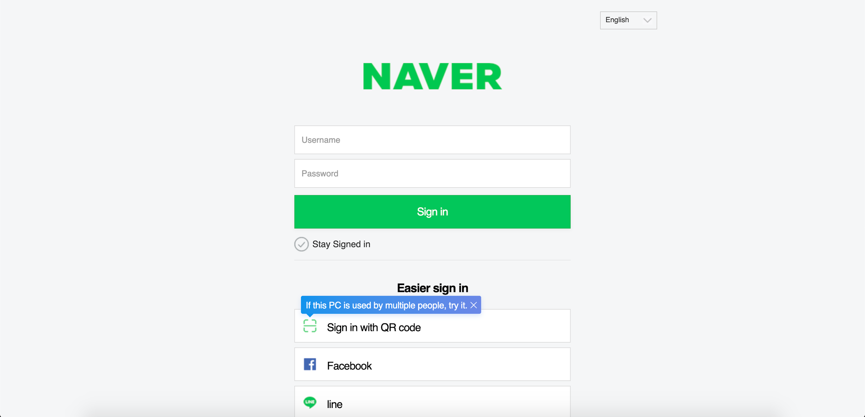
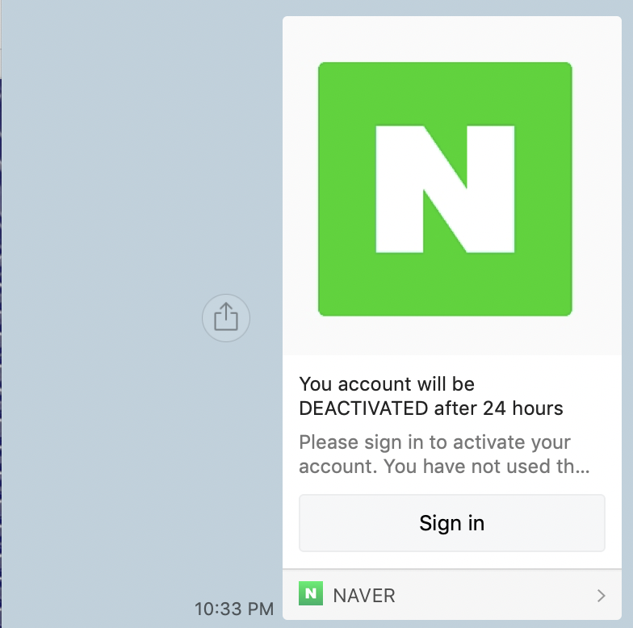
03 PRINCIPLE /// #1
01
KakaoTalk Message
Hacker’s NAVER site
Notes:
Let’s look into principle. When you click ‘Sign in’ button, you move to the Hacker’s NAVER site, which is fake NAVER login site. You might not determine which site is whether fake or not.

Slide 10
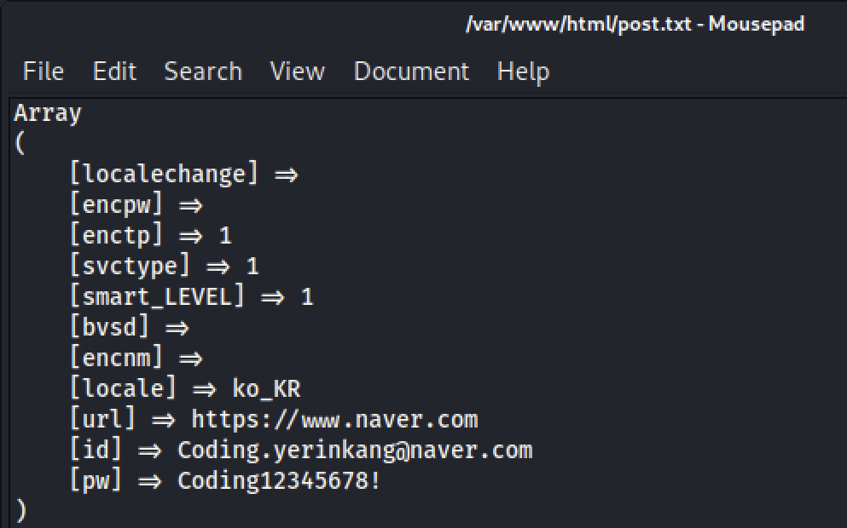
03 PRINCIPLE /// #2
NAVER login site
02
Hacker’s NAVER site
Hacker’s computer
Notes:
You would type your id and pw on these input boxes and click sign in button. As you click sign in button on Hacker’s NAVER site, user move to the real NAVER login page. But, at the same moment, id and pw you type transfer to the hacker’s computer. However, you might think it is just error or you mistype some letters. So, you will type id and pw again on the real NAVER login website. If type correctly, it move to the naver home page. You might not recognize that hacker collect your private information while you sign in.

Slide 11

04 PROTECTION/// #1
01 Use Use technology to protect you
Use security software with anti-phishing technologies (ex. AT&T Internet Security Suite).
01
Notes:
So, how can you protect yourself from phishing sites? First, Use security software with anti-phishing technologies, such as AT&T Internet Security Suite.

Slide 12
04 PROTECTION /// #2
02 Browse securely with HTTPs
Most large online platforms use secure websites. (Also, submitting sensitive information online websites always use HTTPs.)
02
Hacker Website URL:
http://cfba32f83d63.ngrok.io/
NAVER Login Website URL:
https://nid.naver.com/nidlogin.login?mode=form&url=https%3A%2F%2Fwww.naver.com
never.com
Notes:
Second, Most large online platforms use secure websites. Also, submitting sensitive information online websites always use HTTPs. Also, let’s compare the hacker website URL and NAVER login website URL. There is difference between them. Hacker’s website url cannot be same with real NAVER login website URL. But, hacker might be use very similar url to trick the user. For example, never.com something like that.

Slide 13
04 PROTECTION ///#3
03 2-steps verification
Most social media/online platforms have a 2-steps verification system. Although a hacker knows your ID and password, he/she cannot login because it requires your verification from your electronic device.
03
Notes:
Lastly, most social media/online platforms have a 2-steps verification system. Although a hacker knows your ID and password, he/she cannot login because it requires your verification from your electronic device.

Slide 14
CITATION/// YERIN KANG
Image MLA Citation
"FREE AT&T Internet Security Suite Powered By Mcafee - ESL Downloads & Reviews". Eslpc.Com, 2018, https://www.eslpc.com/downloads/mcafee-internet-security-suite-from-att.php. Accessed 21 Dec 2020.

Slide 15

THANKS! /// YERIN KANG
THANKS!

